Slide 1
Python Mini Project
Grocery Giggles – Receipt Generator

Slide 2

Project Title
Title – Grocery Giggles
Subtitle – A user-friendly Grocery shopping
Description – Grocery Giggle is a Python-based application designed to simplify grocery shopping. It allows users to select products across various categories, calculate the total cost, and generate a detailed receipt, including taxes.

Slide 3
Software used
Application used – Visual Studio Code (VSCode)
Programming Language – Python
GUI Library – Tkinter
Additional Libraries – tkinter (for GUI development), ttk (for advanced widgets like combobox)
The project is mainly built using Tkinter library only.

Slide 4
Methodology
HOW GROCERY GIGGLE WORKS –
Step 1: User opens the application, and a scrollable interface appears displaying various product categories.
Step 2: User fills out personal information (Title, First Name, Last Name) using labeled input fields and a dropdown or Combobox.
Step 3: The user selects items from various categories like fruits, dairy products, vegetables, meat, and more using checkboxes.
Step 4: As the user selects items, the total amount and number of selected items dynamically update.
Step 5: The user can click on 'Generate Receipt' to see a detailed receipt, including total price, GST, tax, and the final payable amount.
Step 6: The receipt is displayed in a text widget and saved to a text file for the user’s record.

Slide 5

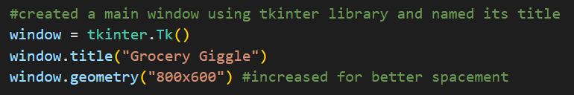
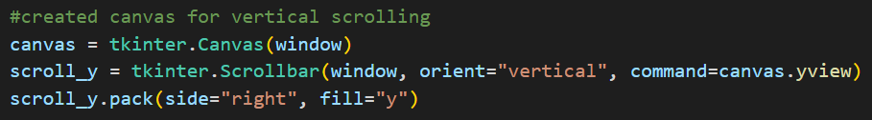
PROJECT SNIPPETS
Importing tkinter library and ttk from tkinter for the GUI application interface
Creating a main window with the title “Grocery Giggles” and added window size for better spacement for the content in it.
Created a scrolling bar using Canvas in tkinter

Slide 6
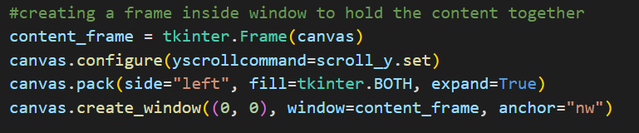
PROJECT SNIPPETS
This code creates a frame (content_frame) inside a canvas to organize content. It sets up vertical scrolling (yscrollcommand) for the canvas and packs it to fill the available space. The create_window method positions the content_frame at the top-left corner, enabling a scrollable layout for holding widgets and elements.

Slide 7
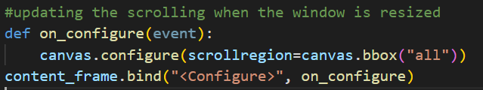
PROJECT SNIPPETS
This code updates the `scrollregion` of the `canvas` using `canvas.bbox("all")` when the `Configure` event occurs, ensuring the scrollable area matches the resized dimensions of the `content_frame`.
Created a label frame that will allow us to add content in it and used “Georgia” as the available font. Here, grid is used for geometry manager for better grid spacing using rows and columns.

Slide 8
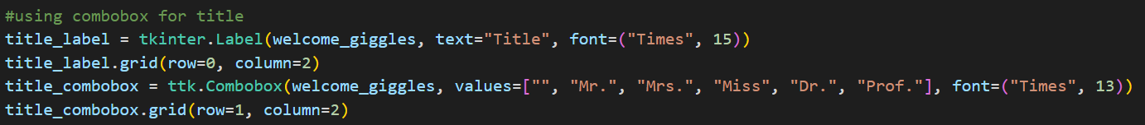
PROJECT SNIPPETS
Created a label entry that includes first and the last name along with which column and row it should reside in.
Here, Combobox from tkinter library is used for dropdown title names – Mr. , Mrs., Miss, Dr., Prof.

Slide 9
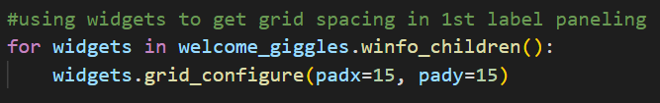
PROJECT SNIPPETS
We have used widgets to have better spacing for the label frames inside parent frame, “welcome_giggles”. For padding around the label frame, we have used padx and pady.
Padx – Adds horizontal padding (left and right) around the widget
Pady – Adds vertical padding (top and bottom) around the widget
Now, we made a dictionary with the products and their title frame names along with their assigned prices.

Slide 10
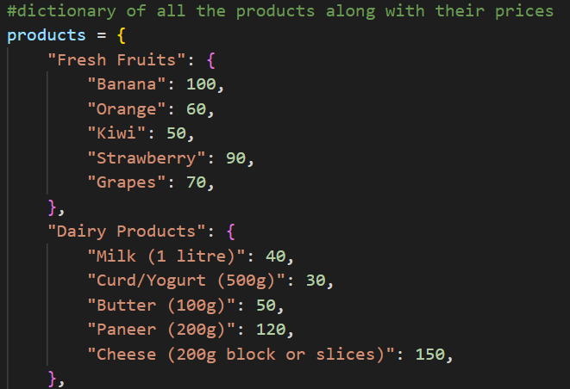
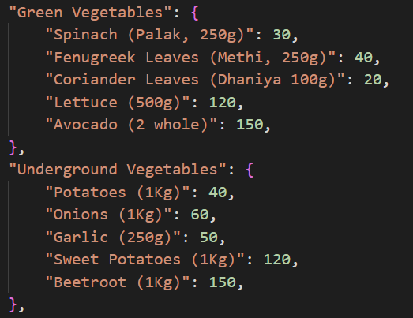
PROJECT SNIPPETS

Slide 11
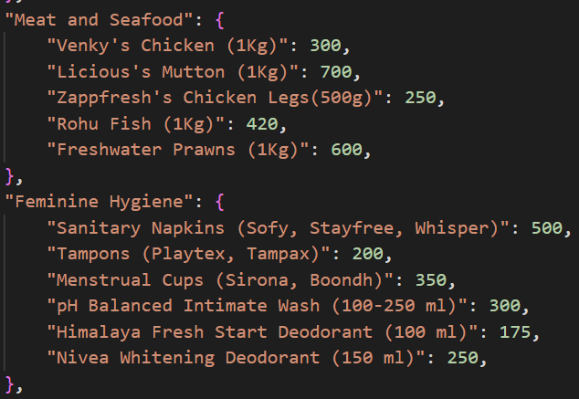
PROJECT SNIPPETS

Slide 12
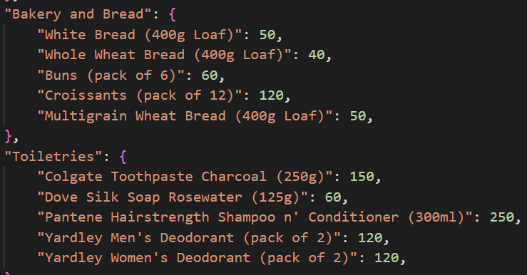
PROJECT SNIPPETS

Slide 13
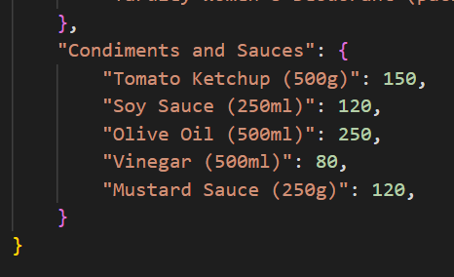

PROJECT SNIPPETS
Dictionary closed after adding all the items in it.
This line creates an empty dictionary called `vars_dict` to hold variables for selections. In a Tkinter application, it is typically used to store control variables (like `IntVar`, `StringVar`, etc.) associated with widgets such as checkboxes, radio buttons, or other inputs, allowing easy access and management of user selections or input values.

Slide 14
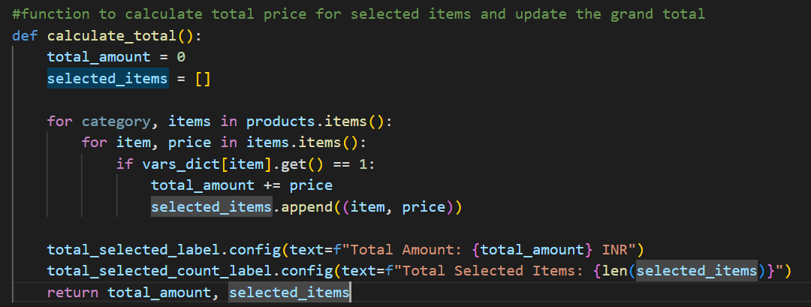
PROJECT SNIPPETS

Slide 15
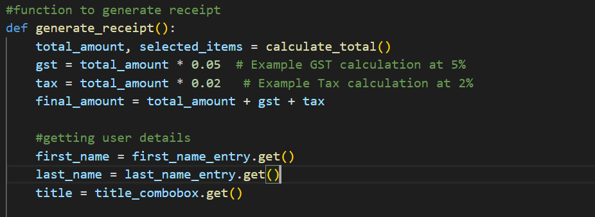
PROJECT SNIPPETS

Slide 16
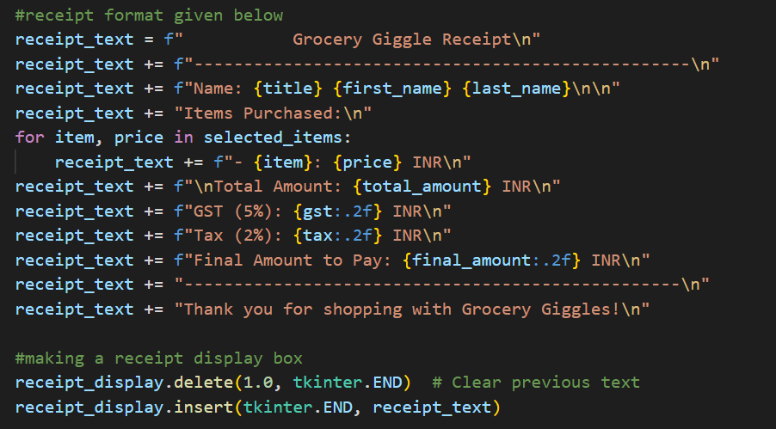
PROJECT SNIPPETS

Slide 17
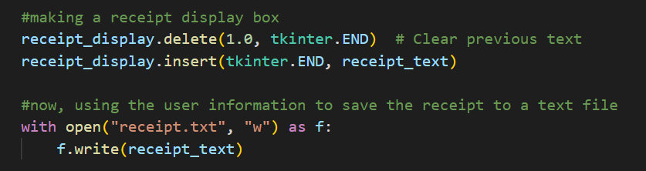
PROJECT SNIPPETS
This code clears any previous text in the receipt display box and inserts new receipt information, allowing users to see the latest details. It then saves this receipt information to a text file named `"receipt.txt"` in write mode, ensuring that all previous content is overwritten. This functionality enables easy access and retrieval of the receipt for future reference, making it convenient for both users and record-keeping purposes.

Slide 18
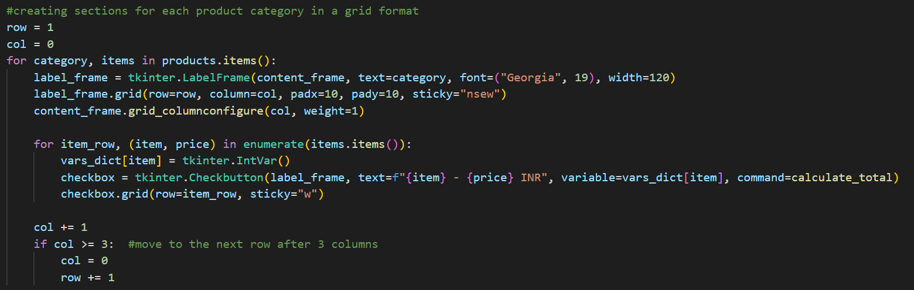
PROJECT SNIPPETS

Slide 19
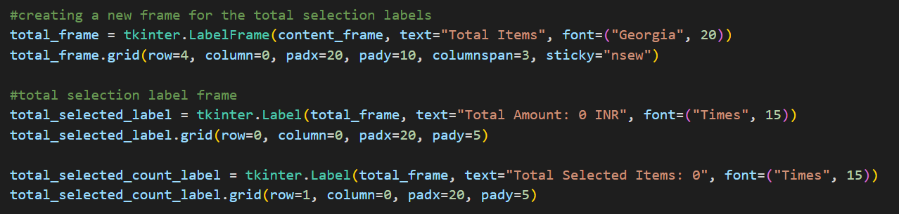
PROJECT SNIPPETS
Creating a new frame called “Total Items” so all the selected items from the checkbuttons are added up for generating a receipt.

Slide 20
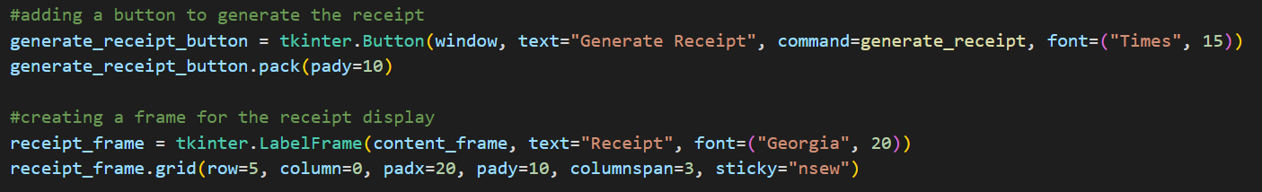
PROJECT SNIPPETS
We have created a Button for generating the receipt which will later save the information in a textfile.
Made another label frame to display the receipt in a box

Slide 21
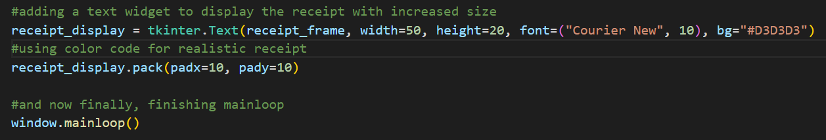
PROJECT SNIPPETS
Here, we have added a Text widget with color code #D3D3D3 and used pack as geometry manager for the boxing of the receipt.
And at last, we finished the mainloop with window.mainloop(), finishing the project.

Slide 22
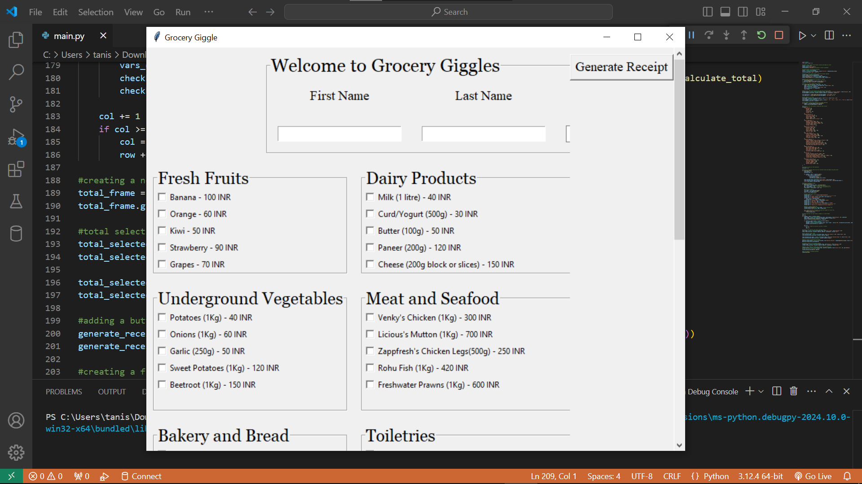
Project OUTPUT

Slide 23
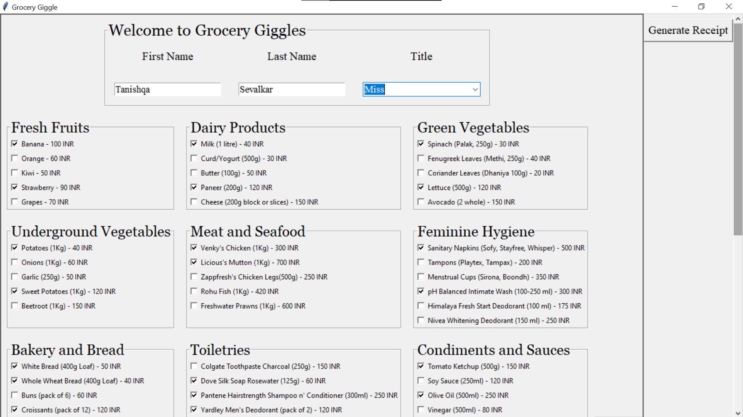
Project OUTPUT

Slide 24
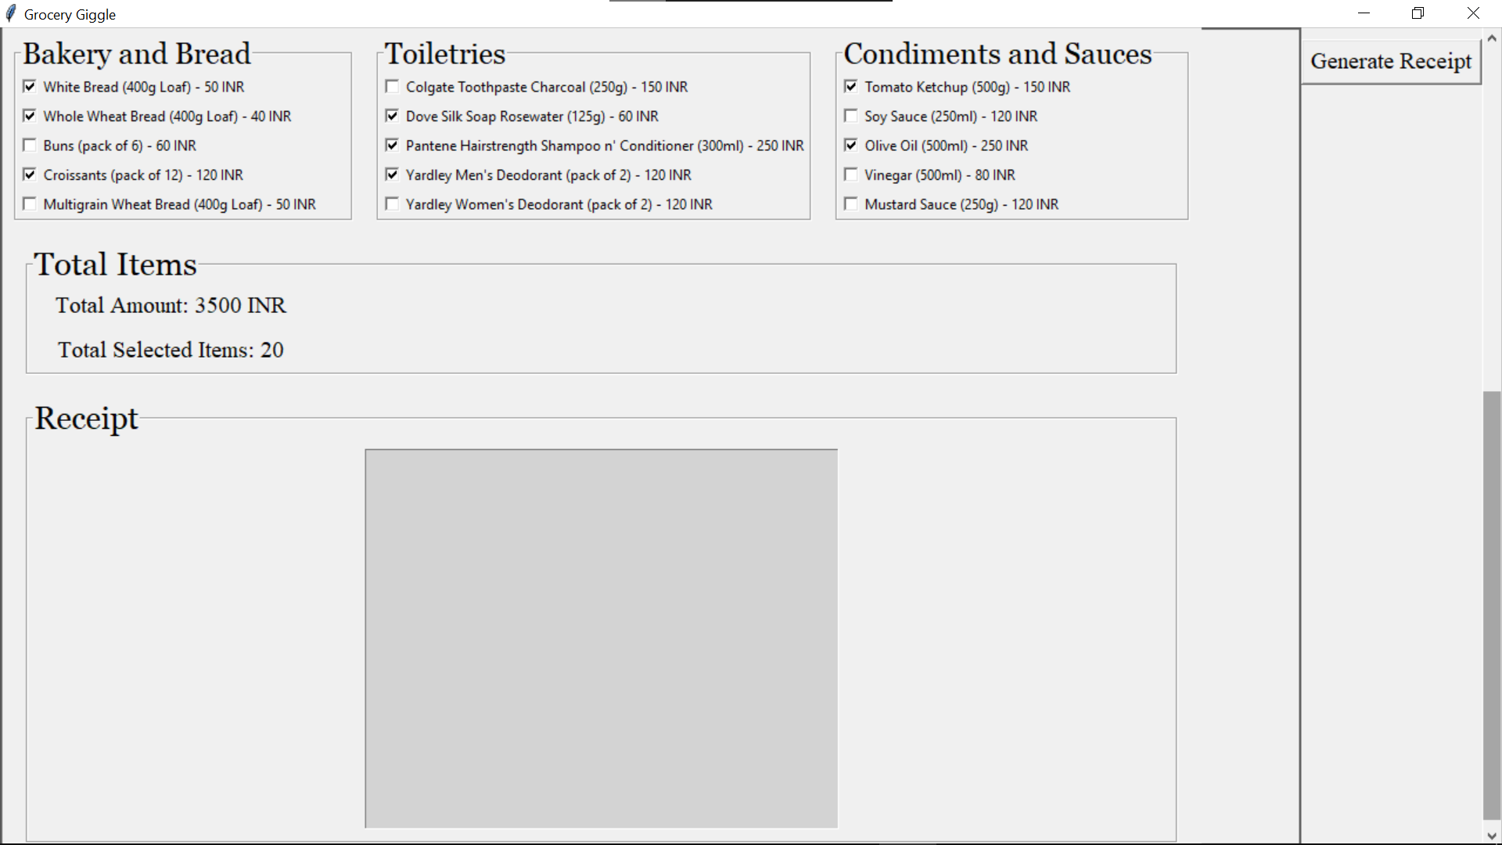
Project OUTPUT

Slide 25
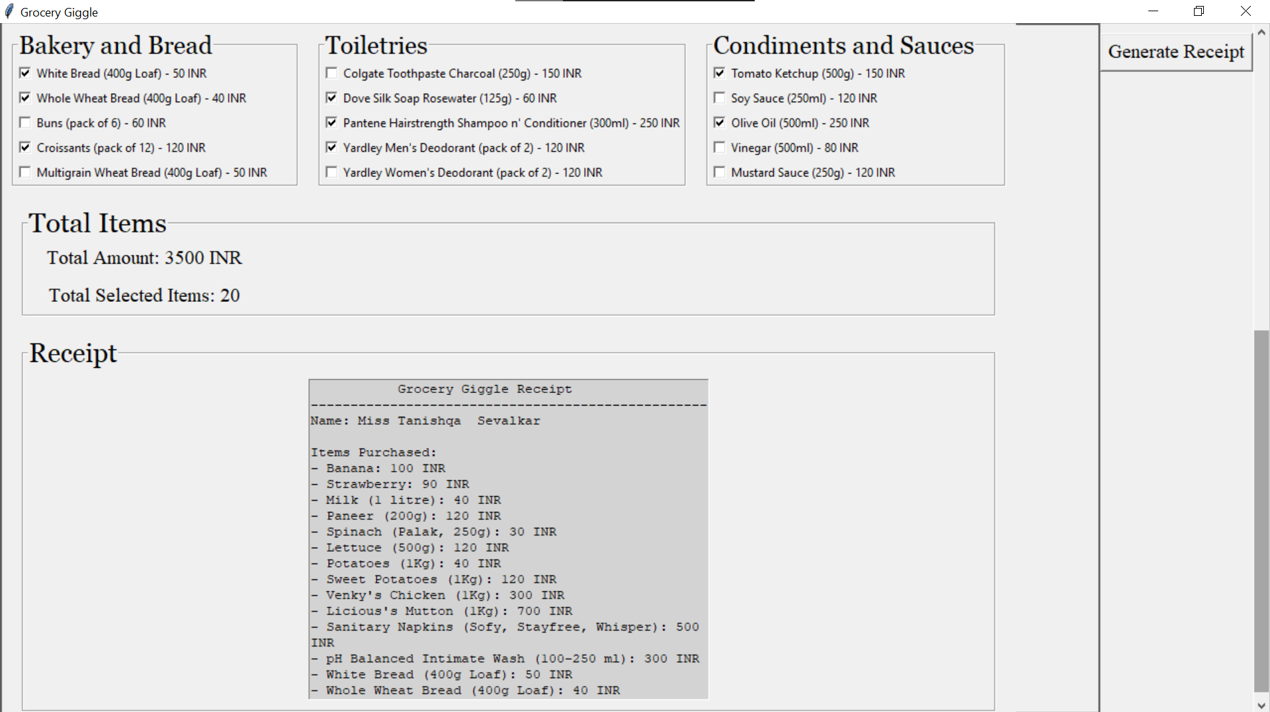
Project OUTPUT

Slide 26
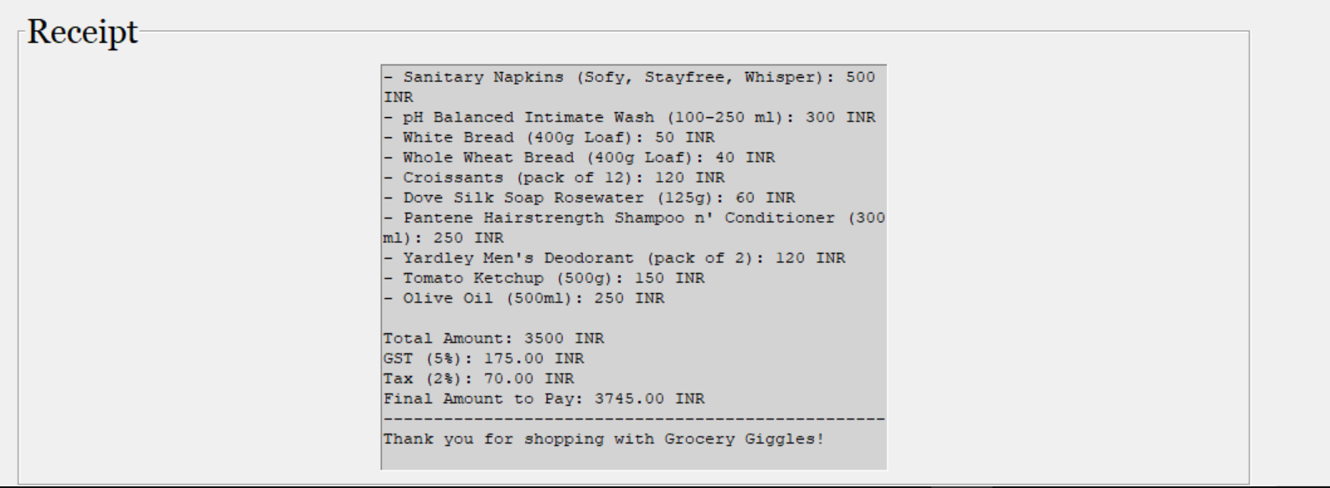
Project OUTPUT

Slide 27
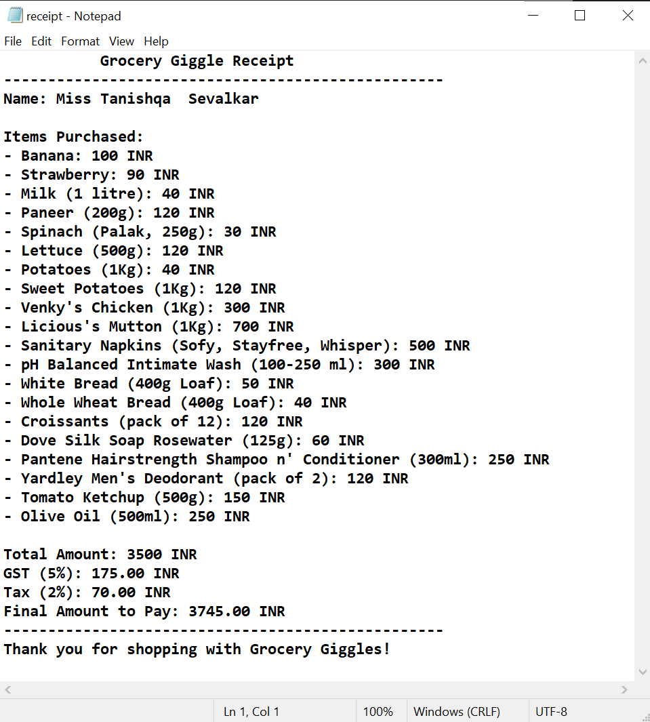
Project OUTPUT
Textfile is saved with the user’s information in downloads file with the price, tax and GST.

Slide 28
Advantages and limitations
Advantages
User-friendly, dynamic interface.
Scrollable design makes it easy to navigate through product categories.
Real-time calculation of total prices and tax details.
Generates a receipt and saves it as a text file for future reference.
Limitations
Limited categories and products; may require manual updating to add more products.
Basic GUI design; lacks advanced features like filtering or search functionality.
No database integration for user management or inventory tracking.

Slide 29
Conclusion
Summary:
Grocery Giggle is a simple, user-friendly application that enables users to select groceries and get a clear breakdown of the costs.
It demonstrates the effective use of Tkinter for GUI applications in Python and serves as a strong foundation for further enhancements.
Future Enhancements:
Adding a database for dynamic product updates.
Integrating user authentication for a personalized experience.
Expanding the scope with more product categories and additional features like discount codes and loyalty points.

Slide 30
References
Tkinter Data Entry Form tutorial for beginners - Python GUI project [responsive layout] – YouTube
https://chatgpt.com/
https://www.w3schools.com/
https://www.geeksforgeeks.org/

Slide 31
THANK YOU!
Tanishqa Dhananjay Sevalkar G-69

